Slide 1
Repertory of Mental Qualities

Slide 2

For more information on Dynamis School teaching both live and online, see
www.dynamis.edu

Slide 3
Finding the right rubric
Patient who cares too much about others, worries about them, and is burnt out from looking after them

Slide 4
?
Cares, full of, others about
Sympathetic
Anxiety others, for
Anxiety - caretaking of others, from
Weakness - nursing and staying up with sick person

Slide 5
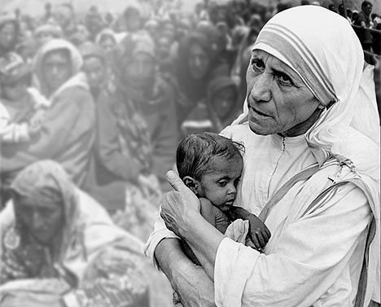
Carers and Helpers

Slide 6
Finding the right rubric
Patient who loves money, worries about not having any and spends too much

Slide 7
?
Fear poverty
Avarice
Ambition increased money to make
Extravagance
Anxiety - money matters, about
Dreams money

Slide 8
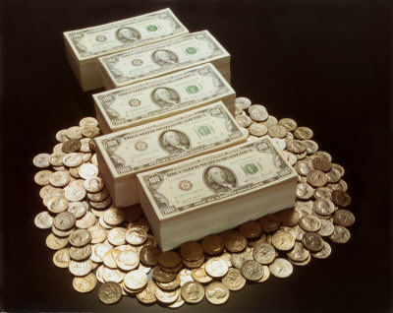
Money

Slide 9
Finding the right rubric
Patient who fear snakes, thinks he sees them, and dreams about them

Slide 10
?
Fear of snakes
Dreams of snakes
Delusion of snakes
Snake remedies

Slide 11
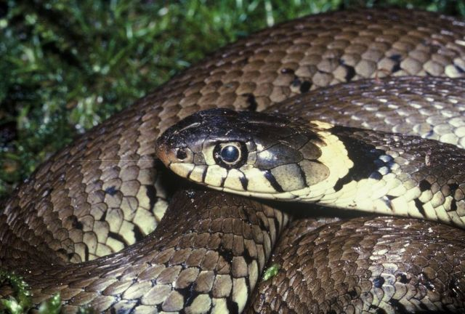
Snakes

Slide 12
Finding the right rubric
Patient with fear of heights, dreams of falling and impulse to jump

Slide 13
?
Fear heights
Desire to Jump
Dreams of falling
Delusions he was in a high place

Slide 14
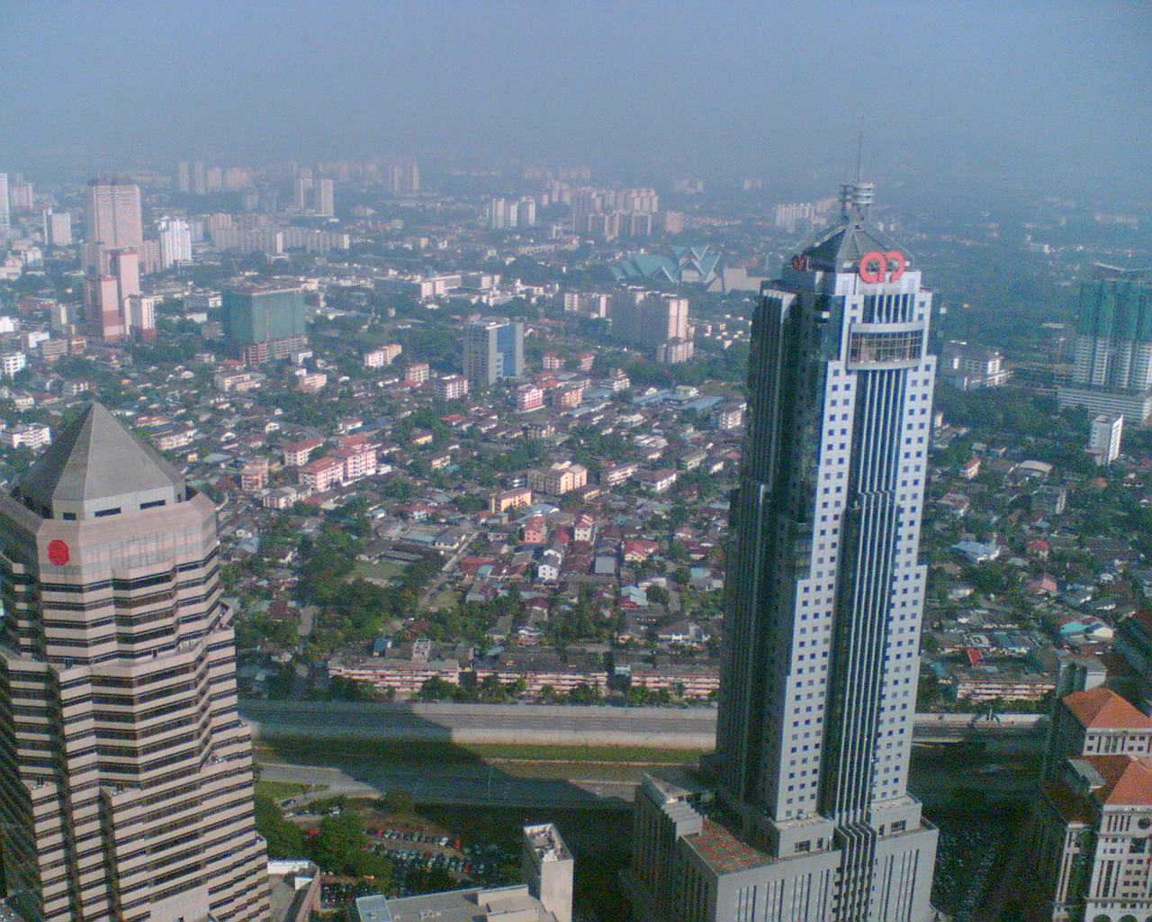
High-low

Slide 15
Rubrics that are just not there when you need them
Low self esteem
Obsessive compulsive
Victim
Perfectionist
Drugs and drug addicts
Opinion of others
Type-A people
Failure

Slide 16
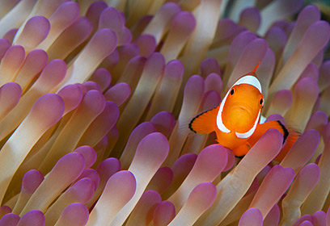
Repertory of Mental Qualities

Slide 17
Jeremy Sherr
Definition of the right rubric
‘The rubric that has the right remedy in it’

Slide 18
Repertory of Mental Qualities
The Mission:
Create a repertory where the right rubric is easy to choose
Create a repertory where the best available remedy must be in the chosen rubric

Slide 19
Repertory of Mental Qualities
The Mission:
Right rubrics + Rubric with right remedy=
Right result

Slide 20
Repertory of Mental Qualities
Quality means individual characteristics of a person.
Quality means a high level of accuracy.
Quality means remedy degrees according to intensity of issue rather than frequency.

Slide 21
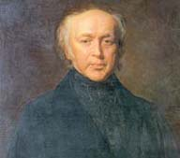
Bonninghausen Method
Use large general rubrics, where you are sure the remedy is in the rubric
Only then go to more characteristics, keynotes and particulars

Slide 22
Bonninghausen Method
More certain results!

Slide 23
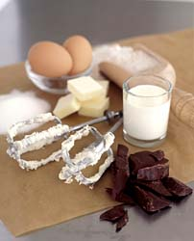
First the Cake
= Large generalised rubrics
Water
Flour
Butter
Sugar
Eggs
Chocolate

Slide 24
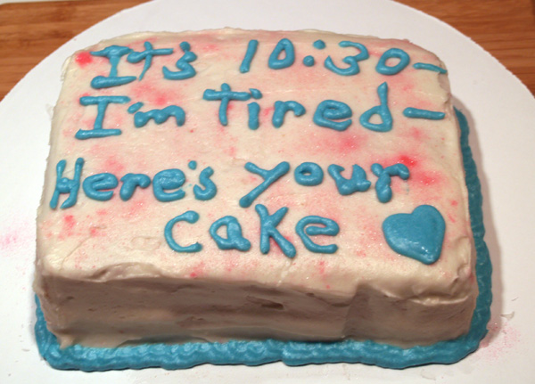
Then the icing!
Strange, Rare and Peculiar

Slide 25
Work wise - not smart
Start by using large and reliable rubrics you are certain about to repertorise to the main group of remedies
Do not repertorise with small, unreliable, or too many rubrics! Leave them for narrowing down your choice, or to check for small remedies

Slide 26
"The Mind is a mine field“
Jeremy Sherr

Slide 27
Introduce the Bonninghausen
Approach to the Mind section
Large general rubrics
MIND SECTION

Slide 28
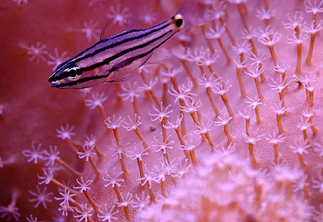
Repertory of Mental Qualities
Rubrics you need in every day practice

Slide 29
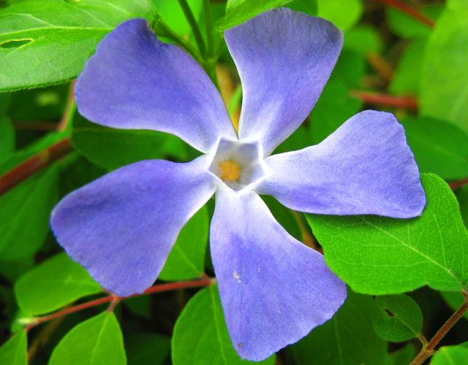
Repertory of Mental Qualities
Rubrics of high quality
With an emphasis on accuracy

Slide 30
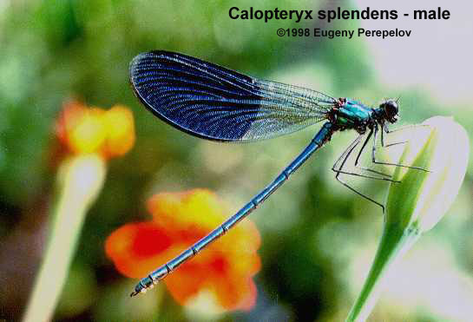
Repertory of Mental Qualities
Rubrics with all the latest information

Slide 31
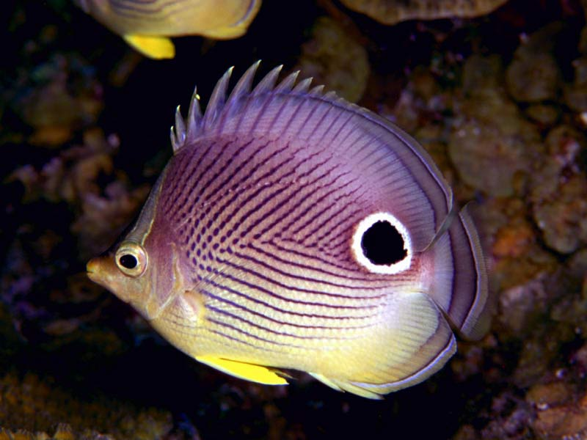
Repertory of Mental Qualities
But only reliable information!

Slide 32
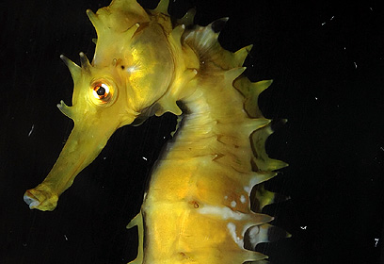
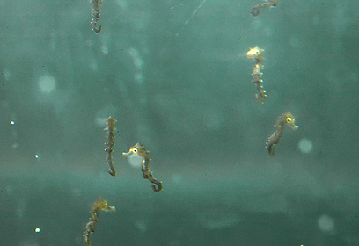
Repertory of Mental Qualities
Rubrics you can count on!

Slide 33
Rubrics you need every day!
Money
Animals
Low self esteem
Victim
Carers and Helpers
Snakes
Female hormones
Clairvoyance
High and low
Water
Dark
Light
Drugs
Music
Insects
Perfectionist
Control
Divided-double
Guilt
Obsessive compulsive
Failure
Ambition
Embarrassment
Opinion of others
Knives and points
Home
Water
Type-A
Big Ego
Trapped

Slide 34
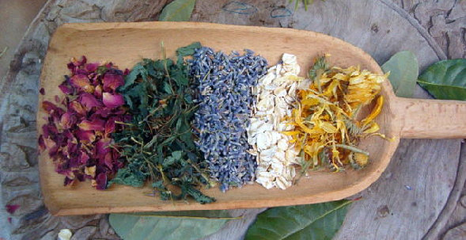
What's in a rubric?

Slide 35
High-low Quality
MIND - HIGH PLACES - agg.
MIND - MODALITIES - HIGH places agg.
MIND - PHENOMENA - FEAR - high places
MIND - FEAR - high places, of
MIND - DELUSIONS - sitting - high; he is sitting too
MIND - DELUSIONS - looking - down; he were looking - high place; from a
MIND - DELUSIONS - lifted; she was being - air; high in the
MIND - DELUSIONS - jumping - high place; off a
MIND - DELUSIONS - high - he were high - houses; higher than the
MIND - DELUSIONS - high - he were high
MIND - DELUSIONS - high - building; stepped from a high
MIND - DELUSIONS - held - sitting; he is held up high when
MIND - DELUSIONS - hanging; is - he or she were hanging - standing high; hanging or
MIND - DELUSIONS - bird - high as a bird, he is
MIND - PHENOMENA - DELUSIONS, imaginations - lifted up, he or she is - high in air, fear he could fall from slightest touch or motion
MIND - PHENOMENA - DELUSIONS, imaginations - hang, hanging - standing high, or is
MIND - HIGH PLACES - desire

Slide 36
High-low Quality
MIND - FEAR - high places, of - pushed by someone behind him; might be
MIND - FEAR - high places, of - others on; seeing
MIND - PHENOMENA - FEAR - high places - pushed by someone behind him, might be
MIND - PHENOMENA - FEAR - high places - throw himself down, lest he
MIND - DELUSIONS - falling - height; from a
MIND - PHENOMENA - DELUSIONS, imaginations - falling - he is - height, from a
MIND - PHENOMENA - DELUSIONS, imaginations - looking down from a height
MIND - PHENOMENA - DELUSIONS, imaginations - jump - height, from a, and land savely, she can
MIND - PHENOMENA - FEAR - falling, of - height, from a
MIND - PHENOMENA - JUMPING - height, from a
MIND - DELUSIONS - jumping - safely; she can jump from a height and land
MIND - DELUSIONS - abyss - falling down an abyss; fear of - others would fall down an abyss, as they stand close to it
MIND - DELUSIONS - abyss - falling down an abyss; fear of
MIND - DELUSIONS - elevated - air; elevated in the - fall; and would
MIND - DELUSIONS - bed - falling - through the bed - floor; and
MIND - DELUSIONS - bed - falling - through the bed
MIND - DELUSIONS - falling - hold onto something; she would fall if she did not

Slide 37
High-low Quality
MIND - DELUSIONS - falling - he is - unpleasantly; she would fall not
MIND - DELUSIONS - falling - he is - suddenly
MIND - DELUSIONS - falling - he is - head; on
MIND - DELUSIONS - falling - he is - deep
MIND - DELUSIONS - falling - he is - children; in
MIND - DELUSIONS - falling - he is - awakening; when
MIND - DELUSIONS - falling - he is - asleep; when
MIND - DELUSIONS - falling - he is
MIND - DELUSIONS - falling - elevated and would fall; he were
MIND - DELUSIONS - falling - clings and asks to be held
MIND - DELUSIONS - falling - seat; he would fall from a
MIND - DELUSIONS - falling - over; he would fall
MIND - DELUSIONS - falling - open space; he would fall in
MIND - DELUSIONS - falling - looks - up; falls if he looks
MIND - DELUSIONS - falling - looks - down; falls if he looks - standing or when walking; when
MIND - DELUSIONS - falling - looks - down; falls if he looks - downstairs; when going
MIND - DELUSIONS - falling - hole close by; danger of falling into a
MIND - DELUSIONS - hanging; is - he or she were hanging - three feet from the ground - asleep; on falling

Slide 38
High-low Quality
MIND - DELUSIONS - lifted; she was being - falling; with fear of
MIND - DELUSIONS - rising - falling; then
MIND - FEAR - falling, of
MIND - FEAR - falling, of - afternoon
MIND - FEAR - falling, of - evening
MIND - FEAR - falling, of - night
MIND - FEAR - falling, of - backward - looking up; when
MIND - FEAR - falling, of - carried; while
MIND - FEAR - falling, of - child holds on to mother
MIND - FEAR - falling, of - children; in
MIND - FEAR - falling, of - descending stairs; when
MIND - FEAR - falling, of - sleep, on going to
MIND - STARTING - anxious - downward motion, from - falling; as if afraid of
MIND - PHENOMENA - BED - fall out, as if he would
MIND - PHENOMENA - DELUSIONS, imaginations - abyss - fear of falling down an
MIND - PHENOMENA - DELUSIONS, imaginations - elevated - air, in - fall, and will
MIND - PHENOMENA - DELUSIONS, imaginations - falling - he is
MIND - PHENOMENA - DELUSIONS, imaginations - falling - he is - waking, on

Slide 39
High-low Quality
MIND - PHENOMENA - DELUSIONS, imaginations - falling - he is - bed - out of
MIND - PHENOMENA - DELUSIONS, imaginations - falling - he is - bed - through the
MIND - PHENOMENA - DELUSIONS, imaginations - falling - he is - bed - through the - through floor
MIND - PHENOMENA - DELUSIONS, imaginations - falling - he is - clings and asks to be held
MIND - PHENOMENA - DELUSIONS, imaginations - falling - he is - downward, into oblivion
MIND - PHENOMENA - DELUSIONS, imaginations - falling - he is - hole, in a
MIND - PHENOMENA - DELUSIONS, imaginations - falling - he is - open space, in
MIND - PHENOMENA - DELUSIONS, imaginations - falling - he is - still, yet feels
MIND - PHENOMENA - DELUSIONS, imaginations - falling - holds on to something, she will fall if she not
MIND - PHENOMENA - DELUSIONS, imaginations - lifted up, he or she is - fear of falling, with
MIND - PHENOMENA - DELUSIONS, imaginations - lifted up, he or she is - fear of falling, with - headache, during
MIND - PHENOMENA - DELUSIONS, imaginations - rising, then falling, of
MIND - PHENOMENA - FEAR - falling, of

Slide 40
High-low Quality
MIND - PHENOMENA - FEAR - falling, of - afternoon
MIND - PHENOMENA - FEAR - falling, of - evening
MIND - PHENOMENA - FEAR - falling, of - night
MIND - PHENOMENA - FEAR - falling, of - carried, being
MIND - PHENOMENA - FEAR - falling, of - children, in
MIND - PHENOMENA - FEAR - falling, of - children, in - hold on to mother, nurse
MIND - PHENOMENA - FEAR - falling, of - looking down agg.
MIND - PHENOMENA - FEAR - falling, of - sleep, on falling asleep
MIND - PHENOMENA - FEAR - falling, of - waking, on
MIND - PHENOMENA - FEAR - falling, of - downstairs
MIND - PHENOMENA - FEAR - falling, of - downstairs - upstairs, and
MIND - PHENOMENA - FEAR - falling, of - high walls and building upon him
MIND - DELUSIONS - bed - falling - out of bed

Slide 41
High-low Quality
MIND - DELUSIONS - air - suspended in the air
MIND - DELUSIONS - beads - she was one of a long string of beads suspended in space
MIND - DELUSIONS - floating - bed - suspended in bed
MIND - DELUSIONS - suspended - he is suspended in the air
MIND - DELUSIONS - suspended - he is suspended in the air - bed; and not lying in
MIND - PHENOMENA - DREAMS - water - falling into
MIND - PHENOMENA - DREAMS - falling - hammock, from a
MIND - PHENOMENA - DREAMS - falling - flood, into a
MIND - PHENOMENA - DREAMS - falling - elevator is
MIND - PHENOMENA - DREAMS - falling - danger of
MIND - PHENOMENA - DREAMS - falling - confidence, with
MIND - PHENOMENA - DREAMS - falling - abyss, into
MIND - PHENOMENA - DREAMS - falling
MIND - PHENOMENA - DREAMS - danger - falling, of
MIND - PHENOMENA - DREAMS - ascending a height
MIND - PHENOMENA - DREAMS - jumping - height, from a, and landing easily
DREAMS - JUMPING - height; from a
DREAMS - FALLING - height, from a
DREAMS - FALLING - danger of - height, from a
MIND - PHENOMENA - DREAMS - high places - save
DREAMS - THROWN; being - high place; from a
DREAMS - HIGH places - ledge - hanging from a
DREAMS - HIGH places
DREAMS - FURNITURE; high - collapsing
MIND - PHENOMENA - DREAMS - falling - house, from roof of
MIND - PHENOMENA - DREAMS - falling - loft, from
MIND - PHENOMENA - DREAMS - falling - pit, into a
MIND - PHENOMENA - DREAMS - falling - window, from, friends
MIND - PHENOMENA - DREAMS - falling - water, into
MIND - PHENOMENA - DREAMS - buildings - high
MIND - PHENOMENA - DREAMS - falling - high places, of
MIND - PHENOMENA - DREAMS - falling - high places, of - men are killed by falling from a height

Slide 42
High-low Quality
MIND - PHENOMENA - DREAMS - falling - high places, of - water, into
MIND - PHENOMENA - DREAMS - high places
MIND - PHENOMENA - DREAMS - ladder, standing on a high
MIND - PHENOMENA - DREAMS - scaffold, he was on a very high, without being anxious
MIND - PHENOMENA - FEAR - falling, of - high walls and building upon him
MIND - PHENOMENA - DELUSIONS, imaginations - square - colossal, of a, surrounded by houses a hundred stories high
MIND - PHENOMENA - DELUSIONS, imaginations - walls - surrounded by high
MIND - DELUSIONS - square surrounded by houses a hundred stories high; sees a colossal
MIND - DELUSIONS - trees - higher; trees seem
MIND - DELUSIONS - walls - surrounded by high walls; being
MIND - FEAR - fall upon him; high walls and building will
MIND - DELUSIONS - objects; about - lean forward and about to fall; high objects
MIND - DELUSIONS - fall; something would - him; on
MIND - DELUSIONS - falling - walls
MIND - DELUSIONS - falling - things will be
MIND - DELUSIONS - falling – showers
MIND - DELUSIONS - house - falling on her; as if houses were
MIND - DELUSIONS - walls - falling; walls are
MIND - DELUSIONS - walls - falling; walls are - inward
MIND - FEAR - falling, of - everything is falling on her
MIND - FEAR - falling, of - houses; of
MIND - FEAR - falling, of - letting things fall, of
MIND - PHENOMENA - DELUSIONS, imaginations - bed - falling on her, everything is
MIND - PHENOMENA - DELUSIONS, imaginations - falling - things will be
MIND - PHENOMENA - DELUSIONS, imaginations - walls - falling
MIND - PHENOMENA - DELUSIONS, imaginations - walls - falling - inward
MIND - PHENOMENA - DELUSIONS, imaginations - walls - falling - inward - convulsions, before epileptic
MIND - PHENOMENA - FEAR - falling, of - houses, of
MIND - PHENOMENA - FEAR - falling, of - things falling on her
MIND - PHENOMENA - FEAR - falling, of - meningitis, in
MIND - PHENOMENA - FEAR - falling, of - pregnancy, in
MIND - PHENOMENA - FEAR - falling, of - room, in warm
MIND - PHENOMENA - FEAR - falling, of - room, in warm - air, open, amel., although he is then chilly

Slide 43
High-low Quality
MIND - PHENOMENA - FEAR - falling, of - forward
MIND - PHENOMENA - FEAR - falling, of - forward - rising, on
MIND - PHENOMENA - FEAR - falling, of - walking, while
MIND - PHENOMENA - FEAR - falling, of - water, into
MIND - PHENOMENA - FEAR - falling, of - turning head, on
MIND - PHENOMENA - FEAR - falling, of - vertigo, in
MIND - PHENOMENA - DELUSIONS, imaginations - falling - he will be, if he stands
MIND - PHENOMENA - DELUSIONS, imaginations - falling - he is - forward, that she is
MIND - PHENOMENA - ANXIETY - fall, to, during walking
MIND - FEAR - falling, of - stooping; on
MIND - FEAR - falling, of - turning head, on
MIND - FEAR - falling, of - walking, when
MIND - FEAR - falling, of - water; into
MIND - FEAR - falling, of - fire; into
MIND - FEAR - falling, of - forwards
MIND - FEAR - falling, of - forwards - rising; on
MIND - FEAR - falling, of - rising; on
MIND - FEAR - falling, of - room agg.; in
MIND - DELUSIONS - falling - backward - side; he would fall backward or to one
MIND - DELUSIONS - falling - backward - rocking in a chair; going over backward when
MIND - DELUSIONS - falling - backward - bed; on getting out of
MIND - DELUSIONS - falling - backward
MIND - DELUSIONS - falling - walking; when - step; he would fall at every
MIND - DELUSIONS - falling - walking; when - if she walks
MIND - DELUSIONS - falling - turns; if he - right or left; to
MIND - DELUSIONS - falling - turns; if he - head; he would fall if he turns his
MIND - DELUSIONS - falling - stands; he will fall if he
MIND - DELUSIONS - falling - side; to one - rising; he would fall to one side on

Slide 44
High-low Quality
- turning head, on
MIND - PHENOMENA - FEAR - falling, of - vertigo, in
MIND - PHENOMENA - DELUSIONS, imaginations - falling - he will be, if he stands
MIND - PHENOMENA - DELUSIONS, imaginations - falling - he is - forward, that she is
MIND - PHENOMENA - ANXIETY - fall, to, during walking
MIND - FEAR - falling, of - stooping; on
MIND - FEAR - falling, of - turning head, on
MIND - FEAR - falling, of - walking, when
MIND - FEAR - falling, of - water; into
MIND - FEAR - falling, of - fire; into
MIND - FEAR - falling, of - forwards
MIND - FEAR - falling, of - forwards - rising; on
MIND - FEAR - falling, of - rising; on
MIND - FEAR - falling, of - room agg.; in
MIND - DELUSIONS - falling - backward - side; he would fall backward or to one
MIND - DELUSIONS - falling - backward - rocking in a chair; going over backward when
MIND - DELUSIONS - falling - backward - bed; on getting out of
MIND - DELUSIONS - falling - backward
MIND - DELUSIONS - falling - walking; when - step; he would fall at every
MIND - DELUSIONS - falling - walking; when - if she walks
MIND - DELUSIONS - falling - turns; if he - right or left; to
MIND - DELUSIONS - falling - turns; if he - head; he would fall if he turns his
MIND - DELUSIONS - falling - stands; he will fall if he
MIND - DELUSIONS - falling - side; to one - rising; he would fall to one side on

Slide 45
High-low Quality
Phatak Boger and other repertories
F - Fear, anxiety, fright - fall upon, him, high walls and buildings
H - High - places agg
L - Looking - upwards - high buildings at agg ptk1
S - Stepping - downstairs agg - high, steps, from ptk1
V - Vision - objects - high, lean forward and about to fall ptk1
MODALITIES - Aggravation - High altitudes
MIND - Fears dread - Downward motion, falling

Slide 46
ABUSIVE - scolds until the lips are blue and eyes stare and she falls down fainting
COMA - eyelids; with falling of

Slide 47
Emphasis on Accuracy and Quality
Every remedy checked by a team of homoeopaths
Every remedy checked to source: proving, cases, authors etc
No automatic combining of rubrics
No automatic inclusion of families based on generalizations
Jeremy’s clinical additions and 28 years of experience

Slide 48
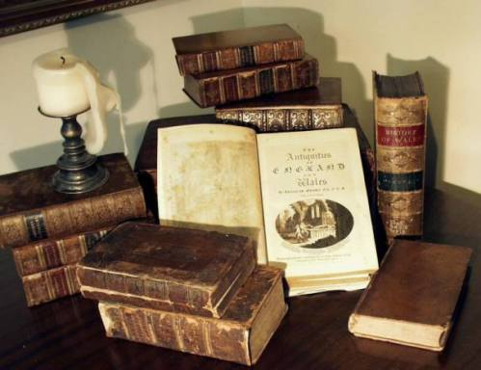
Materia medica

Slide 49


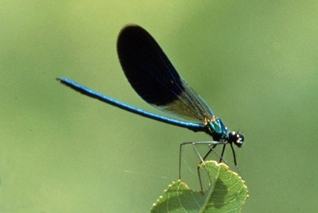
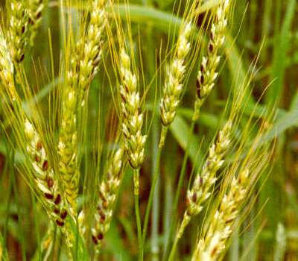
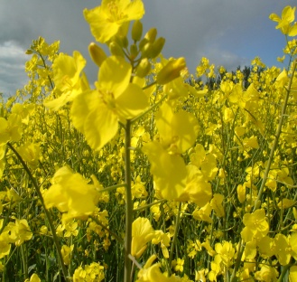
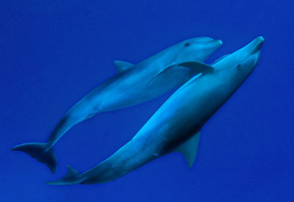
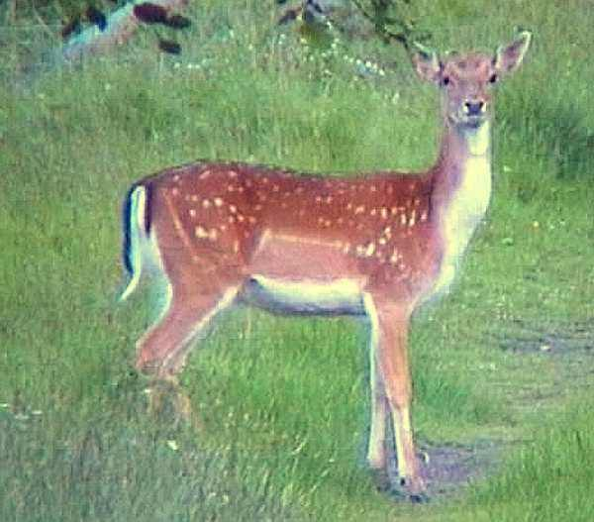
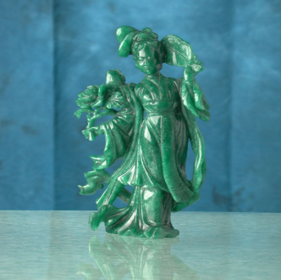
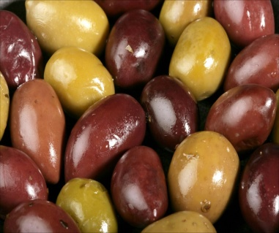
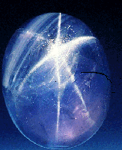
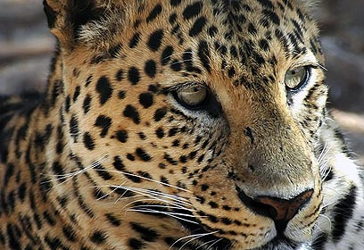
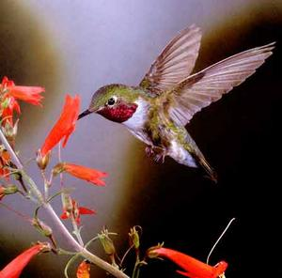
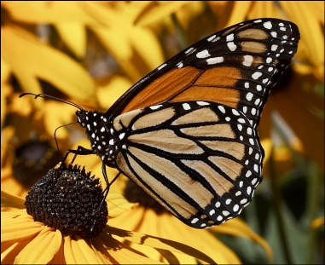
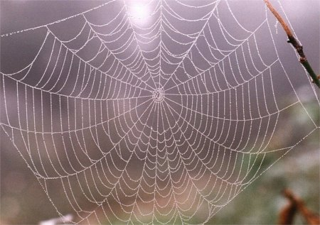
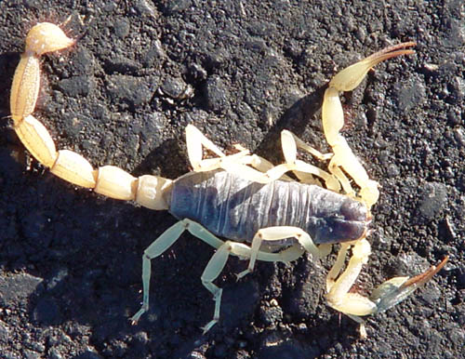
Many new provings

Slide 50
Degrees by Quality
4 BOLD- essential part of remedy
3 Bold- experimental for 4th degree
2 All- possible remedies for this Quality
1 Experimental -possible additions

Slide 51
THE XX Family groups
Aur-XX
Alum-XX
Carbs-XX
Arg-XX
Snakes-XX
Gems-XX
Lacs-XX
Noble gases-XX

Slide 52
Repertory of Mental Qualities
Modern rubrics that you need in every day practice
Rubrics that are easy to choose
Rubrics that include all relevant remedies
Right rubrics +
Rubric with right remedy=
Right result

Slide 53
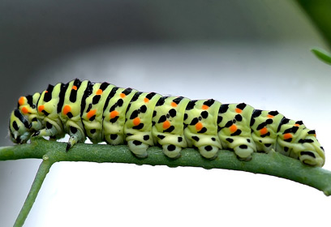
Repertory of Mental Qualities
Keep it simple

Slide 54
Repertory of Mental Qualities
Improve your results!

Slide 55
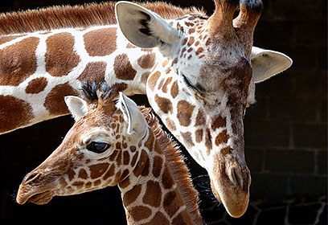
Repertory of Mental Qualities
Enjoy!

Slide 56

Available from Synergy
www. kenthomeopathic.com

